Slide 1
Machine Learning in Practice I
Lecture 9
Antal Jakovac, 2025

Slide 2
Linear regression fitting in a functional basis reliability, overfitting inter- and extrapolation

Slide 3


Linear regression
fitting in a functional basis
in lot of applications the task is to fit a function in a basis
one-dimensional case: function, basis, and we seek :
examples:
  polynomial expansion: → linear fit uses 2D basis
  Fourier expansion:
  Laplace transformation:

Slide 4
Linear regression
fitting in a functional basis
the basis elements should be linearly independent, i.e.
in practice we have data pairs
solve , which means minimize
once we get the coefficients, we can interpolate:
(prediction)

Slide 5
Linear regression
fitting in a functional basis
computation (more elegant than the linear case … )
  introduce vector notation

Slide 6
Linear regression
fitting in a functional basis
computation (more elegant than the linear case … )
  extremum:
  solution: (→ c.f. linear case)
  for uniform correlation matrix:

Slide 7
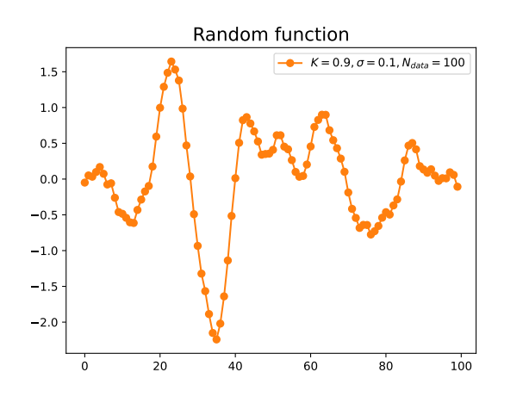
Linear regression
fitting in a functional basis
example:
  create a random function, e.g. damped oscillator with noise
  choose functional basis, e.g. sin-cos
  use the fit formulae

Slide 8
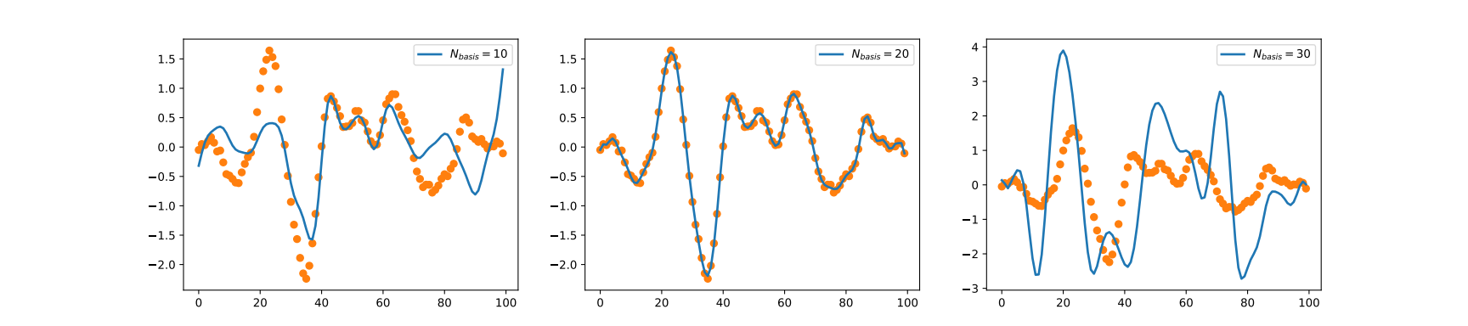
Linear regression
fitting in a functional basis
example:
  result depends on the number of basis elements → non-monotonic!

Slide 9
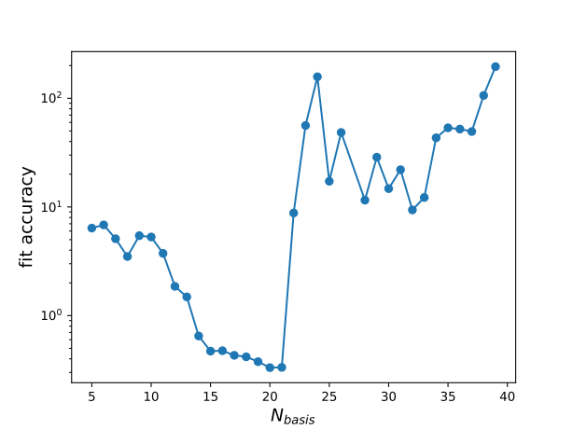
Linear regression
fitting in a functional basis
example:
  result depends on the number of basis elements → non-monotonic!

Slide 10
Linear regression
fitting in a functional basis
what happened?
  we have to invert a matrix:
  what if there are small eigenvalues?

Slide 11
Linear regression
eigenvalues and eigenvectors in nutshell
eigenvectors are stabile directions of a matrix
eigenvectors form a complete basis (in most numerical cases)
matrix functions, defined with Laurent series

Slide 12
Linear regression
eigenvalues and eigenvectors in nutshell – special cases
hermitian matrices: → real symmetric matrices
  eigenvalues are real
  eigenvectors are orthogonal
matrices:
  hermitian
  eigenvalues are non-negative (positive definite)

Slide 13
Linear regression
fitting in a functional basis
what happened?
  we have to invert a matrix:
  what if there are small eigenvalues?
a linear equation → how reliable is it?
add an eigenvector to the solution!
if numerical tolerance is →
if can be very large!

Slide 14
Linear regression
fitting in a functional basis
typical value:
  measurement errors
  numerical calculation errors
ill-conditioned matrices: there are eigenvalues
the inverse is not reliable!
very common in higher dimensions! → in ML or AI
never use the naive linear equation solving formulae!

Slide 15
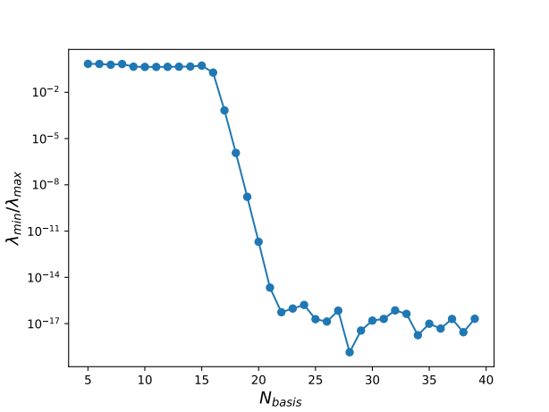
Linear regression
fitting in a functional basis
in our example: for we reached Python’s precision
after that value the fitting precision is drastically reduced

Slide 16
Linear regression
fitting in a functional basis
what can we do with an ill-conditioned matrix?
  pseudo-inverse
  regularization

Slide 17
Linear regression
pseudo-inverse
assume we can add the smallest eigenvector(s) with arbitrary coefficients
choose that value that leads to the smallest length
lesson: we should leave out all small eigenvectors!
in formula:

Slide 18
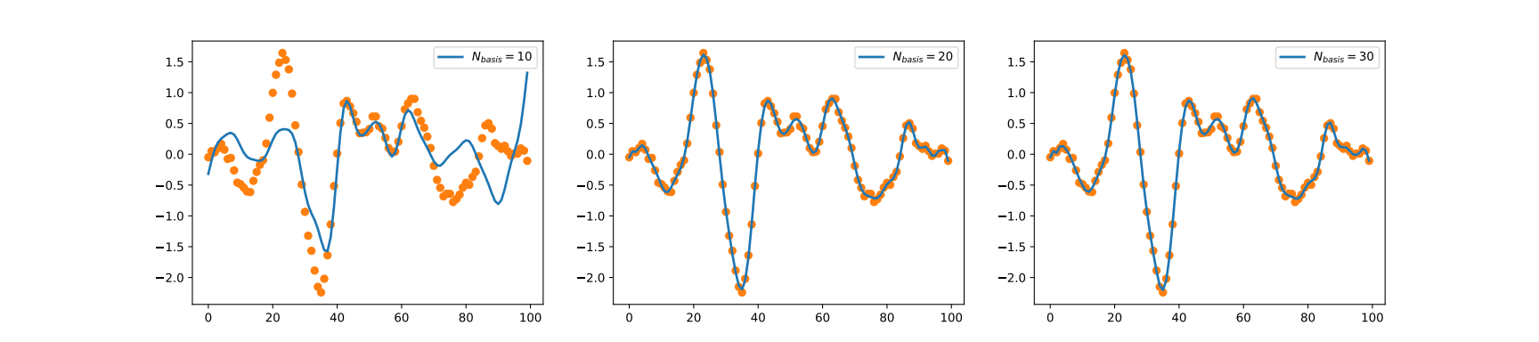
Linear regression
# pseudoinverse fitting
nus = np.linspace(1,30,Nnu)
base1 = [[np.cos(np.pi*nu*n/Ndata) for n in range(Ndata)] for nu in nus]
base2 = [[np.sin(np.pi*nu*n/Ndata) for n in range(Ndata)] for nu in nus]
f = np.array(base1+base2).T
c = np.linalg.pinv(f.T@f)@f.T@y
plt.plot(f@c)
pseudo-inverse
in Python code

Slide 19
Linear regression
pseudo-inverse works well, but closely connected to linear algebra
more general method: regularization
idea: add extra term to the loss function
  stabilize result
  spoils close connection to data
  tradeoff: should use in a balanced manner
most frequently used: L1,L2 regularization, MEM

Slide 20
Linear regression
L2 regularized loss
formally: add a small number to the matrix to be inverted
works only for positive definite matrices (true in our case)

Slide 21
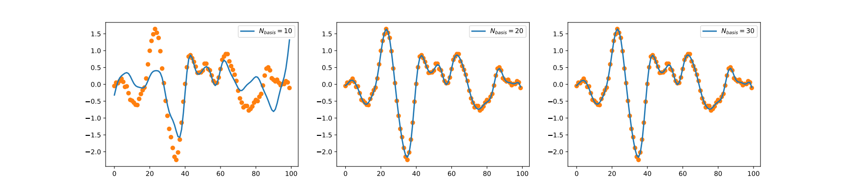
Linear regression
L2 regularized loss results

Slide 22

Linear regression
L1 regularized loss – also for positive definite matrices
minimization with numerical methods

Slide 23
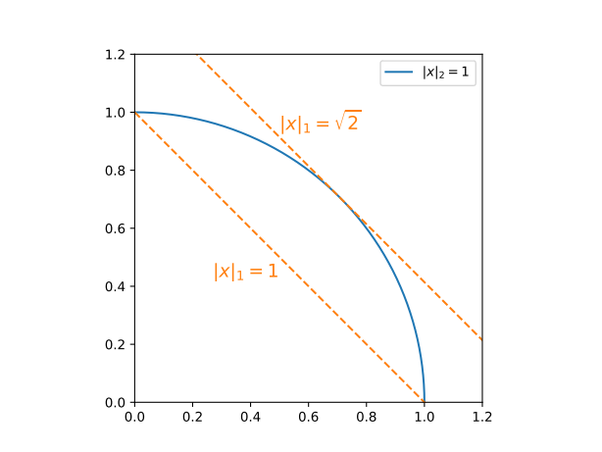
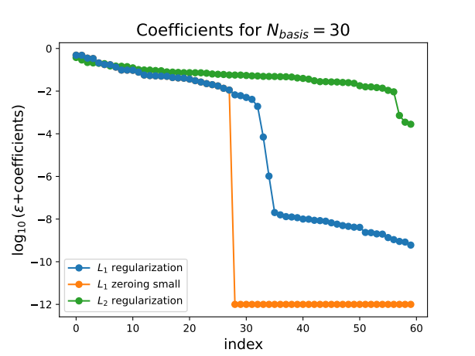
Linear regression
L1 regularization benefit: likes small coefficients
reason:
can be used to eliminate features → c.f. previous plot

Slide 24
END OF LECTURE 9

